Slide 2
Decision Trees & Ensemble Models
Lecture 3

Slide 3
Course Schedule
Lecture 1: Introduction to Tree-Based Method
Lecture 2: Bias-Variance Tradeoff and Ensembling Approaches
Lecture 3: Bootstrap sampling
Lecture 4: Random Forests
Lecture 5: Boosting
Lecture 6: Project Presentation

Slide 4
Agenda
Class review
Bootstrapping
Bagging
Random Forests
General Ensembling
Summary

Slide 5
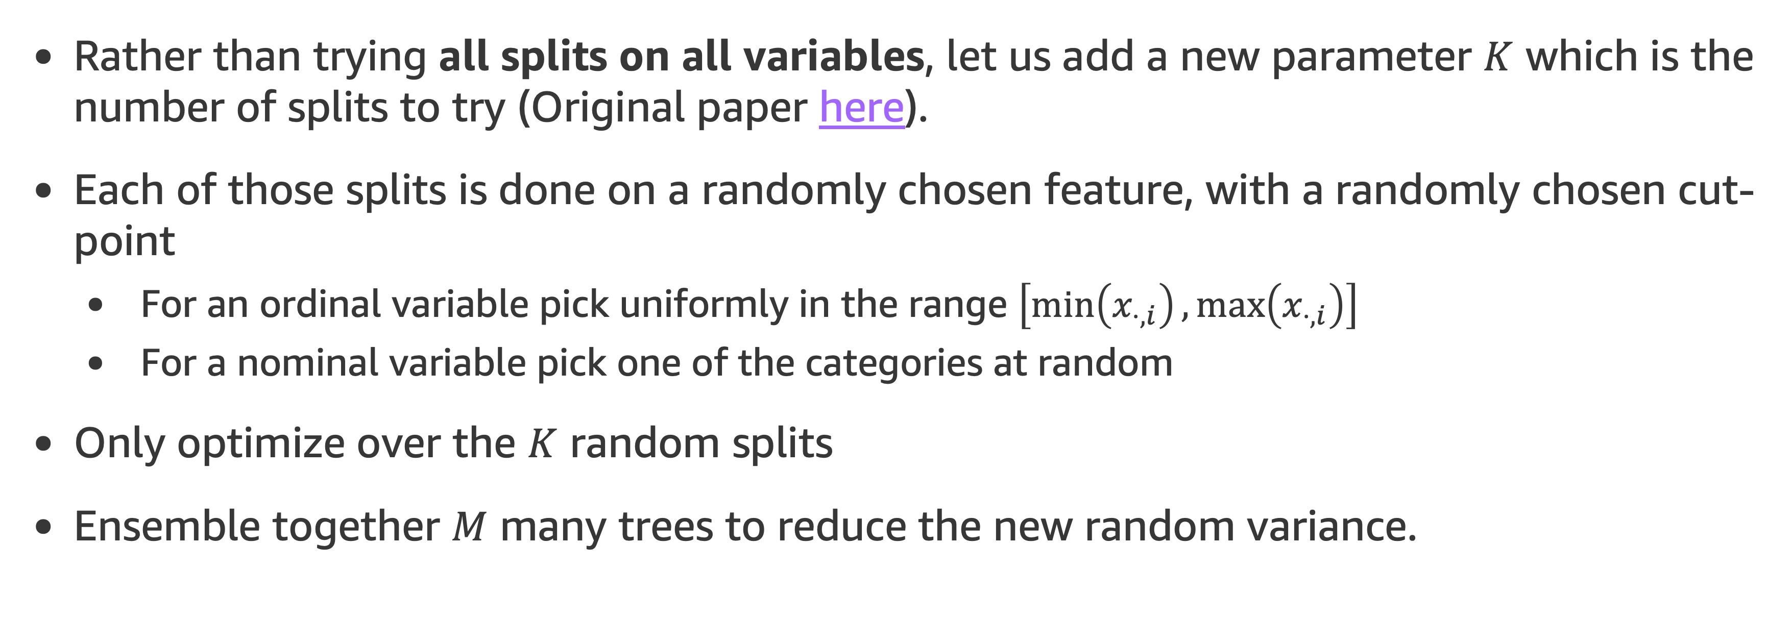
The ExtraTrees Algorithm
Rather than trying all splits on all variables, let us add a new parameter $K$ which is the number of splits to try (Original paper here).
Each of those splits is done on a randomly chosen feature, with a randomly chosen cut-point
For an ordinal variable pick uniformly in the range $\left[\min\left(x_{⋅,i}\right),\max\left(x_{⋅,i}\right)\right]$
For a nominal variable pick one of the categories at random
Only optimize over the $K$ random splits
Ensemble together $M$ many trees to reduce the new random variance.

Slide 6
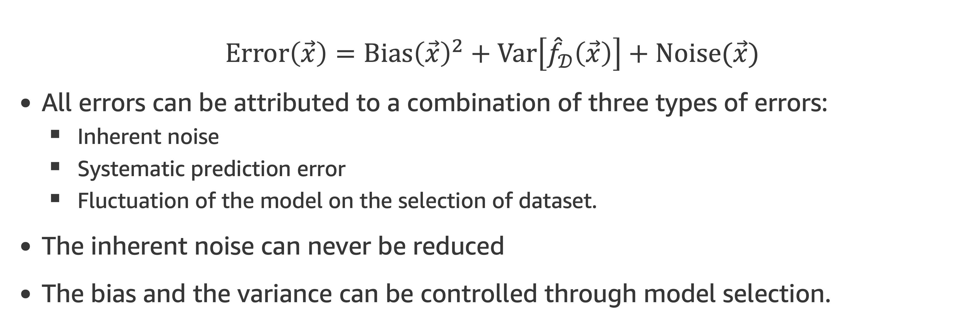
The Bias-Variance Decomposition
$$Error\left(\vec{x}\right)=Bias{\left(\vec{x}\right)}^{2}+Var\left[{\hat{f}}_{𝒟}\left(\vec{x}\right)\right]+Noise(\vec{x})$$
All errors can be attributed to a combination of three types of errors:
Inherent noise
Systematic prediction error
Fluctuation of the model on the selection of dataset.
The inherent noise can never be reduced
The bias and the variance can be controlled through model selection.

Slide 7
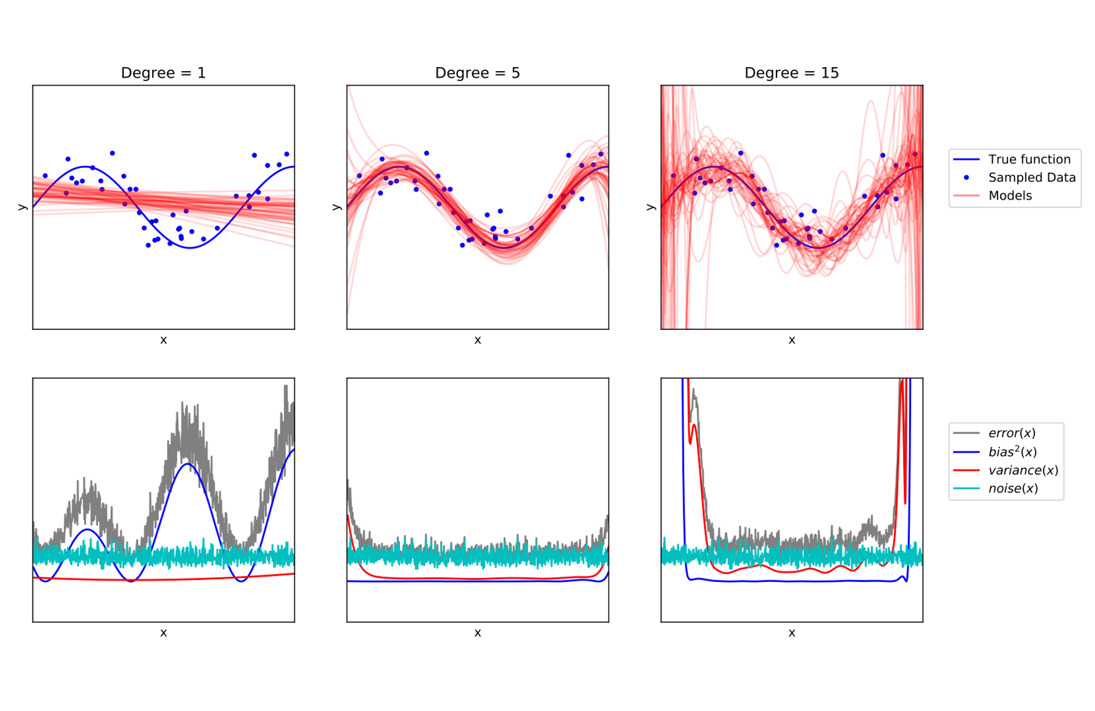
Bias-variance and Model Performance
Underfitting: Low model complexity. Corresponds to high bias and low variance.
Overfitting: Over-complex model and it doesn’t generalize well. Corresponds to low bias and high variance.

Slide 8
Bias-variance and Model Performance
Underfitting: Low model complexity. Corresponds to high bias and low variance.
Overfitting: Over-complex model and it doesn’t generalize well. Corresponds to low bias and high variance.
Example: Fitting multiple polynomials to a set of data points. We are using an example from here: Understanding Random Forests, p.58

Slide 9
Bias-variance and Model Performance
Example: Fitting multiple polynomials to a set of data points. We are using an example from here: Understanding Random Forests, p.58
Blue line is the true function. Red lines are multiple polynomials (in top figures).
Understanding Random Forests, p.58

Slide 10
Bias-variance and Model Performance
Example: Fitting multiple polynomials to a set of data points. We are using an example from here: Understanding Random Forests, p.58
Blue line is the true function. Red lines are multiple polynomials (in top figures).
Polynomial with degree=1: Underfits with high bias, low variance
Polynomial with degree=15: Overfits with low bias, high variance
Understanding Random Forests, p.58

Slide 11
Agenda
Class review
Bootstrapping
Bagging
Random Forests
General Ensembling
Summary

Slide 12
Bootstrapping – What is the goal?
Let us start with a simple problem:
We are given a bunch of prices of houses, and we want to know the median price of a house.
We can compute the median directly
But how can we compute the error bars?
A few issues:
If it was the mean, we could make some assumptions and apply standard statistical techniques
But house prices do not satisfy the requirements (too long of tail)
No similar technique exists for the median anyway
A bunch more examples are here.

Slide 13
Bootstrapping – What is the goal?
ExtraTrees is nice, but very tree specific (even specific to our chosen learning algorithm for the trees)
“Can we find an ensembling technique that can work for any model?”

Slide 14
Bootstrapping – What is the goal?
In general, if there is no explicit formula for the distribution of errors (and in ML there almost never are) there will not be any simple way to try to understand accuracy of measure values.
However, if we had infinite data, it’d be easy:
Measure the quantity in many independent datasets of the same fixed size
Use the empirical distribution to provide the distribution.

Slide 15
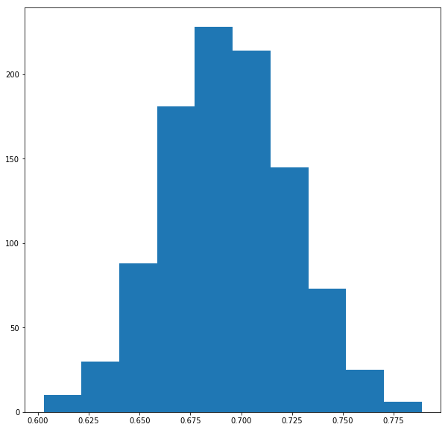
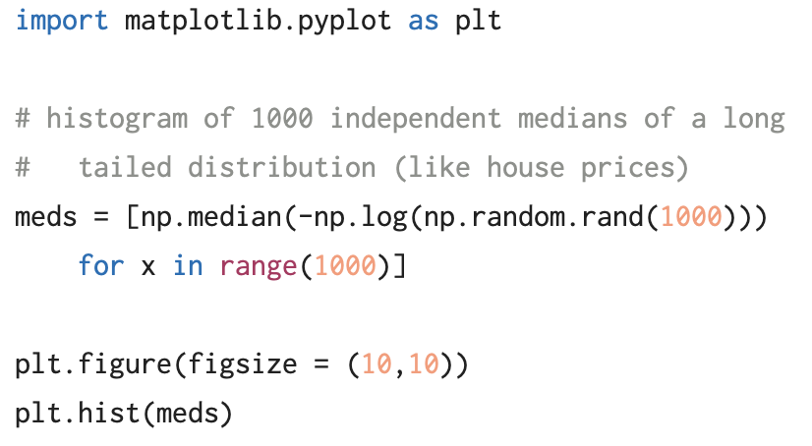
Bootstrapping – Our Example
True:
DTE-LECTURE-3-BOOTSTRAP.ipynb

Slide 16
Bootstrapping – What is the goal?
The problem here is that you never will have infinite data! You will get your 1000 data points once, and then need to work from that.
The question becomes:
“How can we expand a single fixed dataset to treat it like 1000 independent ones?”

Slide 17
Sampling with replacement
What happens if we treat our data as the true distribution, and draw synthetic data datasets from this?
To create synthetic datasets, we sample with replacement from our dataset:
Given dataset: [1, 2, 4, 5, 7, 9,10], median: 5
Potential samples with associated medians:
[ 1, 1, 2, 4, 9,10,10], median: 4
[ 2, 4, 5, 5, 7, 7, 7], median: 5
[ 1, 1, 1, 1, 1, 1, 1], median: 1
[ 1, 2, 4, 5, 7, 9,10], median: 5
…
The distribution of these medians gives us a guess at the true distribution of the medians over a dataset of this size.

Slide 18
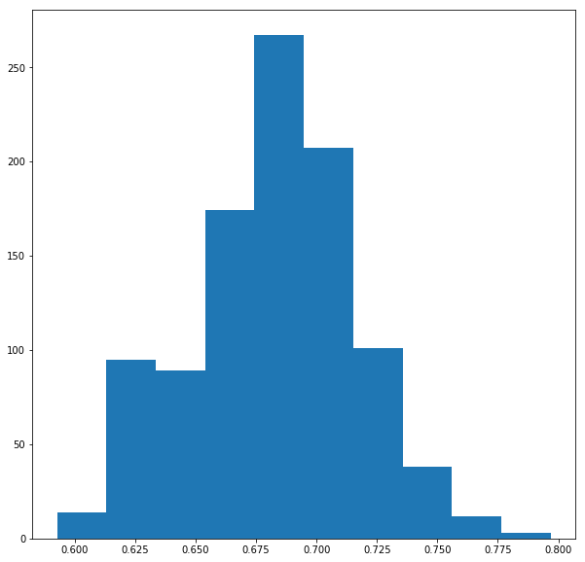
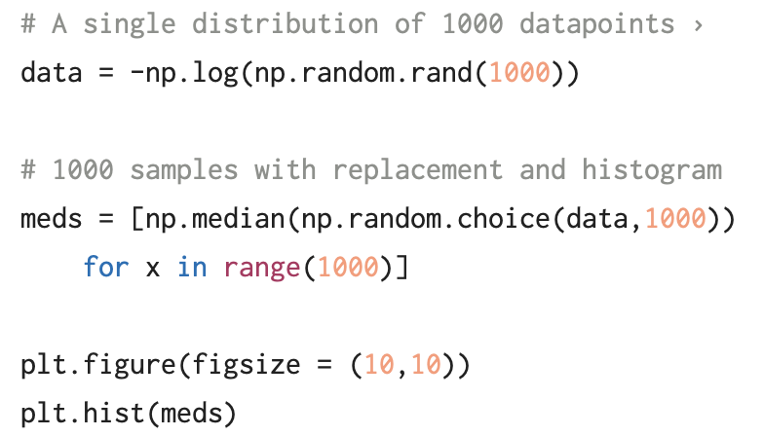
Sampling with replacement – Our Example
Bootstrap:
DTE-LECTURE-3-BOOTSTRAP.ipynb

Slide 19
Sampling with replacement – Our Example
True
Bootstrapped
DTE-LECTURE-3-BOOTSTRAP.ipynb

Slide 20
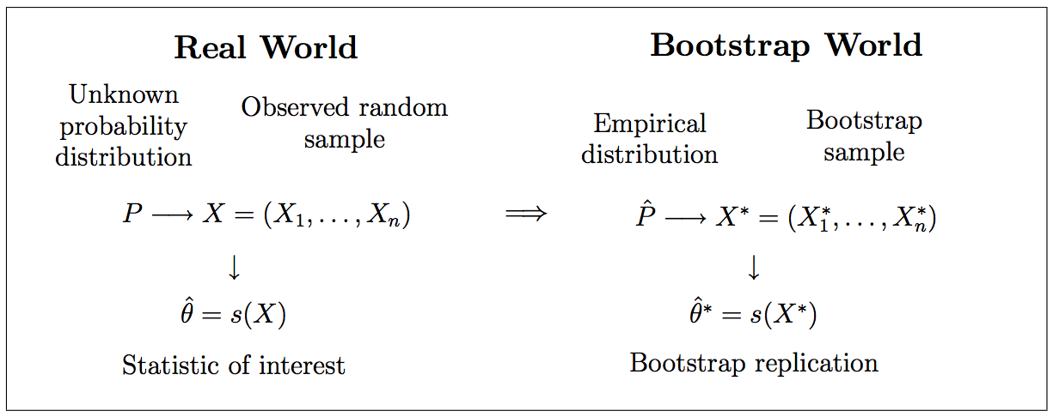
Sampling with replacement – Our Example

Slide 21
Agenda
Class review
Bootstrapping
Bagging
Random Forests
General Ensembling
Summary

Slide 22

Bootstrapping in ML
This is all fine and good, but how does this apply to machine learning?
Recall the bias/variance decomposition from before:
$$Error\left(\vec{x}\right)=Bias{\left(\vec{x}\right)}^{2}+Var\left[{\hat{f}}_{𝒟}\left(\vec{x}\right)\right]+Noise(\vec{x})$$
Total error
Systematic error
Random error from dataset fluctuation
Intrinsic randomness in problem
Bootstrapping allows us to mitigate this!

Slide 23
Bootstrap Aggregating: Bagging
Given a dataset D with n samples in it
Separate it into m different random samples with replacement: D_{m}
These may have a smaller number of points if desired
Train m models f_{m} on the sampled datasets D_{m}
Produce the final prediction by either averaging f_{m} (for regression problems) or voting with f_{m} (for classification problems)

Slide 24
Bagging
By randomly subsampling the dataset when we train a ML model, we can (to a certain degree) try to capture, and reduce the variance due to dataset selection
This is conditional: it only works if the model being trained is unstable: if the model predictions change dramatically for small changes in dataset
Examples which are unstable: decision trees (think about the narrow bands from end-cut preference), neural networks
Example that are not: k-nearest neighbors

Slide 25
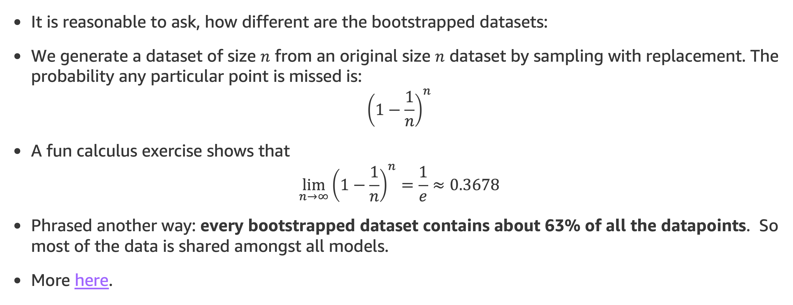
How different are the datasets
It is reasonable to ask, how different are the bootstrapped datasets:
We generate a dataset of size $n$ from an original size $n$ dataset by sampling with replacement. The probability any particular point is missed is:
$${\left(1−\frac{1}{n}\right)}^{n}$$
A fun calculus exercise shows that
$$\lim_{n→∞}{{\left(1−\frac{1}{n}\right)}^{n}}=\frac{1}{e}≈0.3678$$
Phrased another way: every bootstrapped dataset contains about 63% of all the datapoints. So most of the data is shared amongst all models.
More here.

Slide 26
Out-of-bag Error
Bagged models have a natural way to evaluate generalization.
On each datapoint, have the models that were not trained on that datapoint vote.
The out-of-bag error is then the error of the aggregated model on these predictions.
In the Bag
Out of the Bag
Train Here
Predict Here

Slide 27
Bagging in Sklearn
Sklearn provides a very general interface for bagging which can be provided any base_estimator:
BaggingClassifier(base_estimator=None, n_estimators=10, max_samples=1.0, bootstrap=True, oob_score=False)
The full interface is larger.

Slide 28
Bagging Trees
Given a dataset D with n samples in it
Separate it into m different random samples with replacement: D_{m}
These may have a smaller number of points if desired
Train m models trees f_{m} on the sampled datasets D_{m}
Produce the final prediction by either averaging f_{m} (for regression problems) or voting with f_{m} (for classification problems)
Exactly the general technique but for trees!

Slide 29
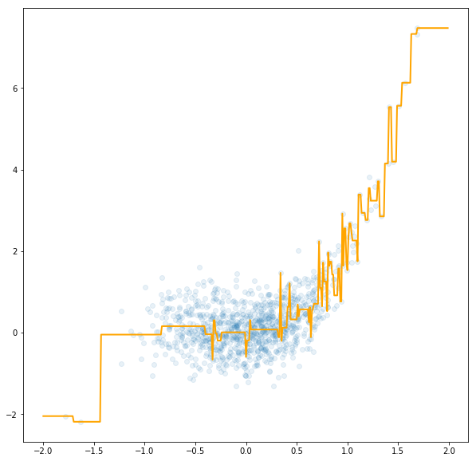
An example: Overfit regression
Tree with max_depth=8
Suppose we want to use a decision tree to perform a non-linear regression problem.
If a single tree is used it can overfit leading to odd fluctuations
Here the tree is restricted to have max_depth=8
y
DTE-LECTURE-3-BAGGING-OVERFIT.ipynb
x

Slide 30
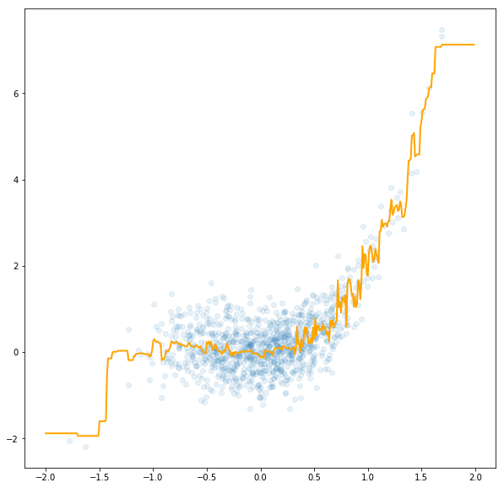
An example: Overfit regression
Bagging of 100 Trees
If we bag (100 trees) with samples the same size as the original, we get some improvement, but particularly prevalent outliers still influence it
This is because the probability any point is in a sample is about 63%, so outlier points remain common in most trees.
y
DTE-LECTURE-3-BAGGING-OVERFIT.ipynb
x

Slide 31
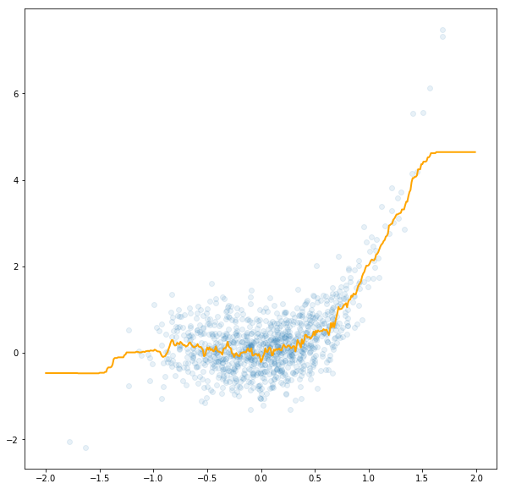
An example: Overfit regression
Bagging of 100 Trees with 10% of data
If we now reduce the number of samples seen per tree (to 10% of the original data set) we trade off for some additional bias (data in sparsely sampled regions are lost) but we gain a great reduction in overfitting.
y
DTE-LECTURE-3-BAGGING-OVERFIT.ipynb
x

Slide 32
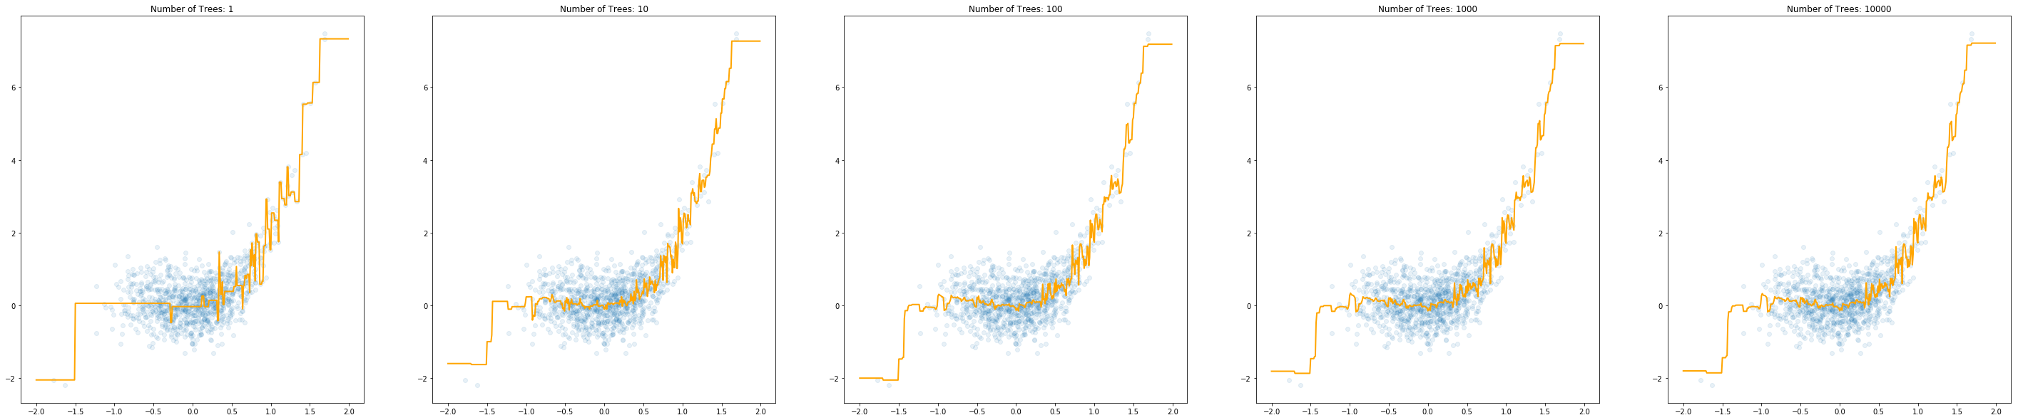
Limitations of Simple Bagging
This is an artifact of all of our trees essentially sharing much of the same dataset:
Note that past about 10-100 trees, it is just wasted effort.
DTE-LECTURE-3-TREE-CORRELATION.ipynb

Slide 33
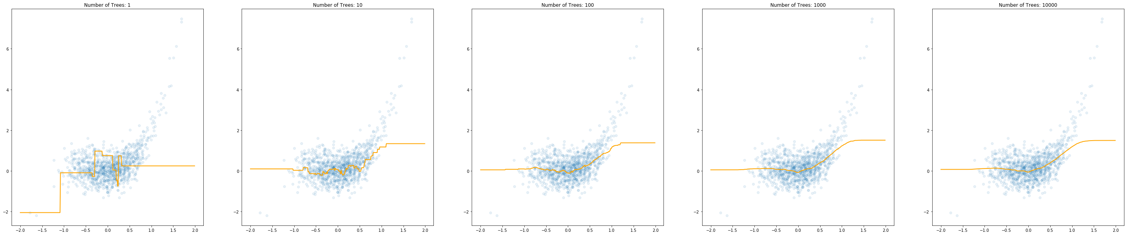
Limitations of Simple Bagging
Correlations between trees sampled from the bootstrap cause this (not sufficiently unstable).
We already saw a way around this: reduce the size of the sampled dataset (here we take an extreme 1% of the data in each tree).
In this case every extra tree continues to matter!
DTE-LECTURE-3-TREE-CORRELATION.ipynb

Slide 34
Agenda
Class review
Bootstrapping
Bagging
Random Forests
General Ensembling
Summary

Slide 35
Random Forest – Core Idea
We will first discuss a method called the Random Subspace method for building a random forest
What if we don’t just randomize the datapoints given to each tree, but the features as well.
If two trees are given disjoint features, then their predictions will be as independent as the dataset itself was.
Intuitively: if different trees trained on different features in different data all agree on the same conclusion, we can be very confident on the conclusion!
This decreases correlation between different trees, or alternatively increases the instability of the estimator.

Slide 36
Issue: Extra Hyperparameter
Now in addition to picking various things like the maximum depth of the tree, and the size of the random subset used, we now also need to include the number of features used.
Optimize this using a validation set or out-of-bag error.
Good place to start for classification seems to be:
For regression, something like half the total number of features seems to work better (no particular theory here I’m afraid)
$$number of features per tree=\sqrt{number of features total}$$

Slide 37
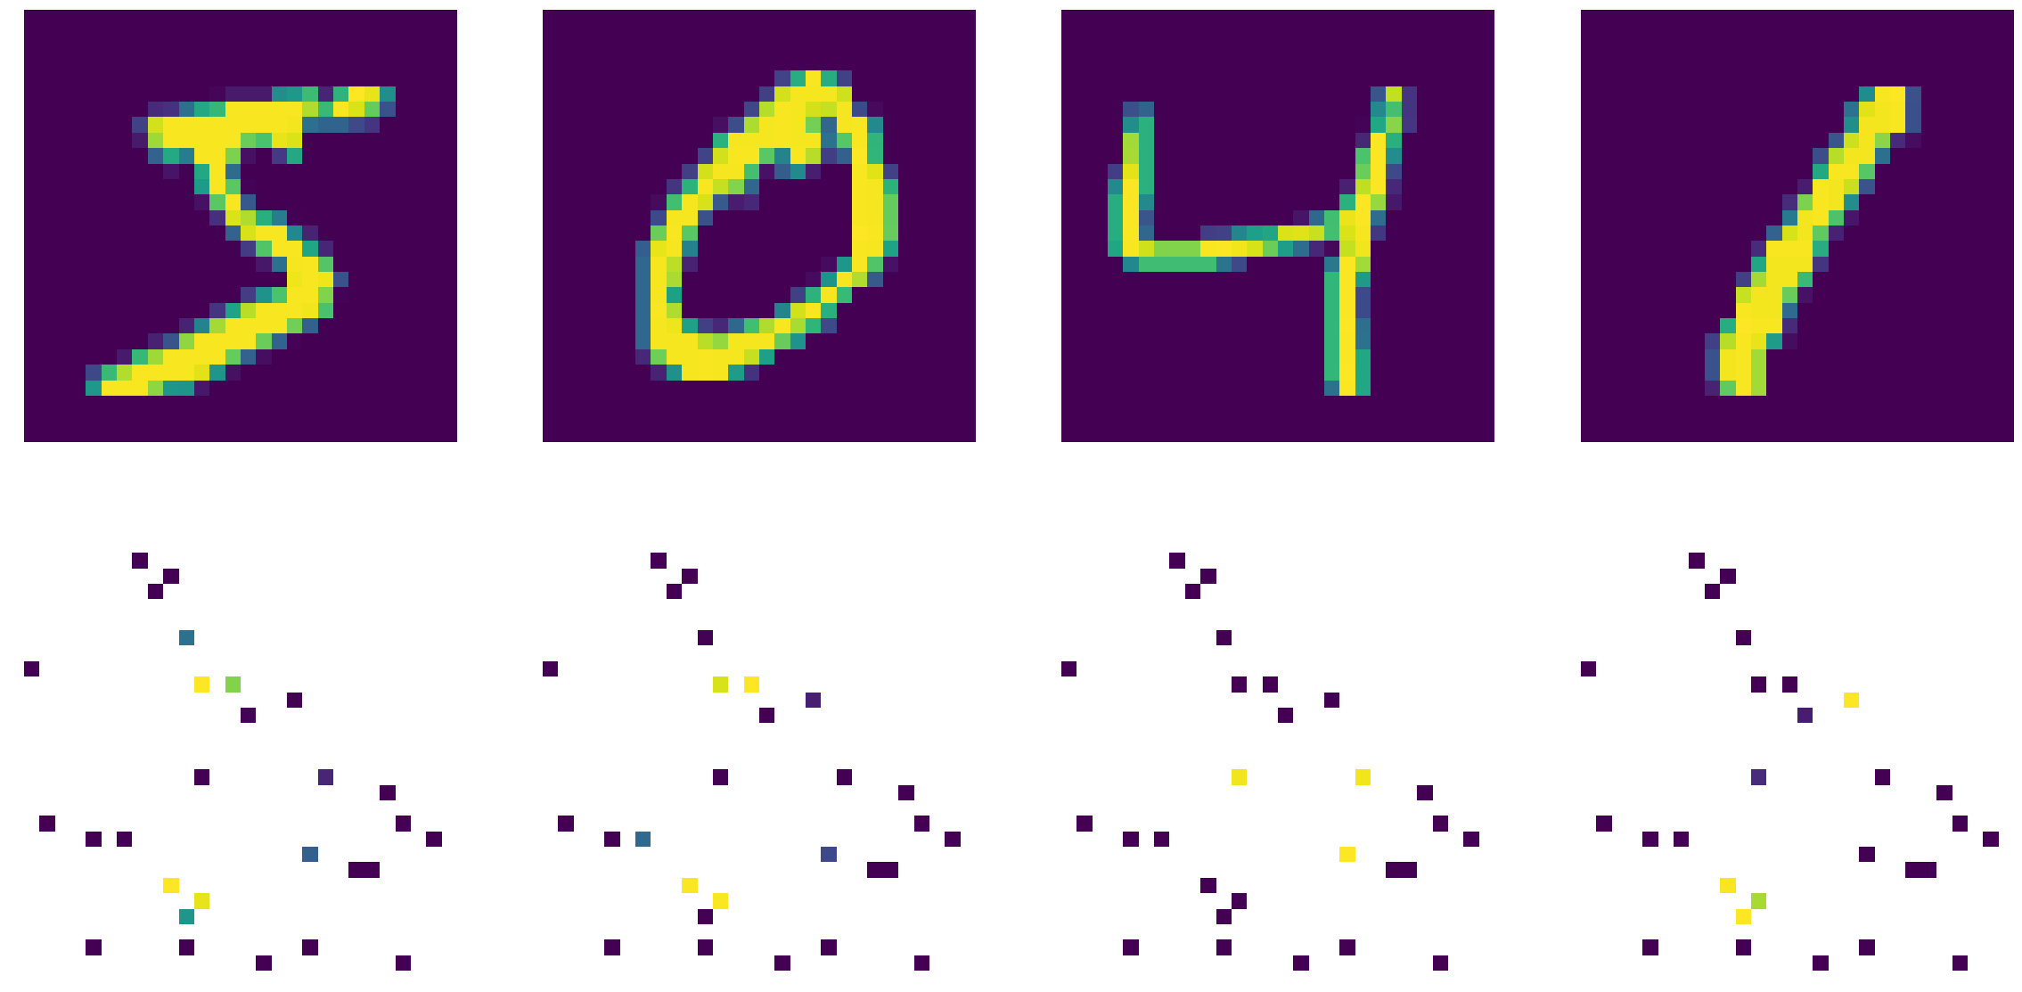
Digit Example
This is a simple idea, so lets take a look at how it helps avoid overfitting in MNIST (Digit Classification)
Original data
Selected pixels
DTE-LECTURE-3-RANDOM-FOREST.ipynb

Slide 38
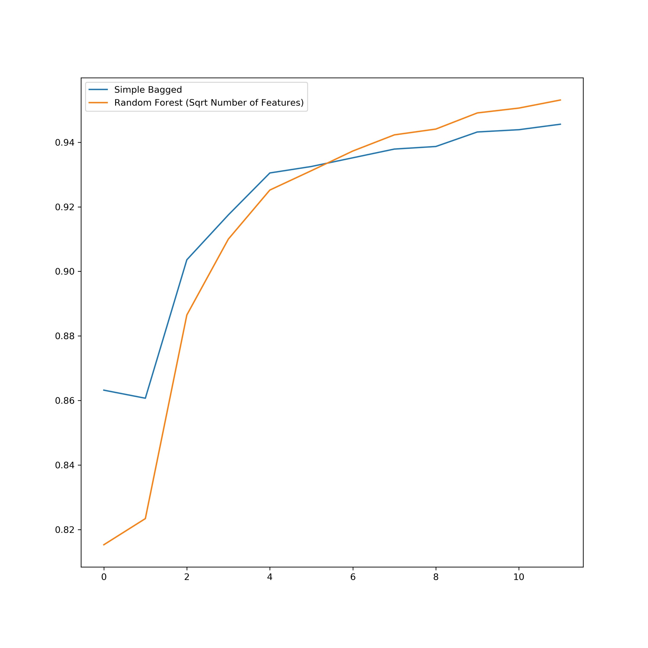
Digit Example
This is a simple idea, so lets take a look at how it helps avoid overfitting in MNIST (Digit Classification)
The plot on the right shows the test score on Bagged versus Random Forest
Each tree in the forest does worse than in the bag, but the aggregate is better.
Test Accuracy
DTE-LECTURE-3-RANDOM-FOREST.ipynb
Number of predictors

Slide 39
Random Forests in Sklearn
The interface is again familiar (abbreviated here):
RandomForestClassifier(n_estimators=100, criterion=’gini’, max_depth=None, min_samples_split=2, min_samples_leaf=1, min_weight_fraction_leaf=0.0, max_features=’auto’, max_leaf_nodes=None, min_impurity_decrease=0.0, min_impurity_split=None, bootstrap=True, oob_score=False, n_jobs=1)

Slide 40
A Pleasant Bonus
We began using random feature subsets so that we could have an additional tool to decorrelate trees and increase the ability of our random forests to avoid overfitting
There is another big gain: efficiency! Every tree now only needs to consider a small fraction of features, and thus they can be trained in a fraction of the time!
Time to produce graph for full features: 12 minutes
Time to produce graph for subset of features: 25 seconds

Slide 41
Other Common Random Forests
Rather than selecting a subset of the features for each tree, each node may instead inspect it’s own random subset of features.
This is the one you’ll encounter in sklearn
One can also combine with ExtraTrees for additional decorrelation
The splits can be chosen to separate two randomly chosen points of different classes leading to what are known as Perfect Random Tree Ensembles (PERT). Paper here.
See Section 4.3.1 from Understanding Random Forests for many more.

Slide 42
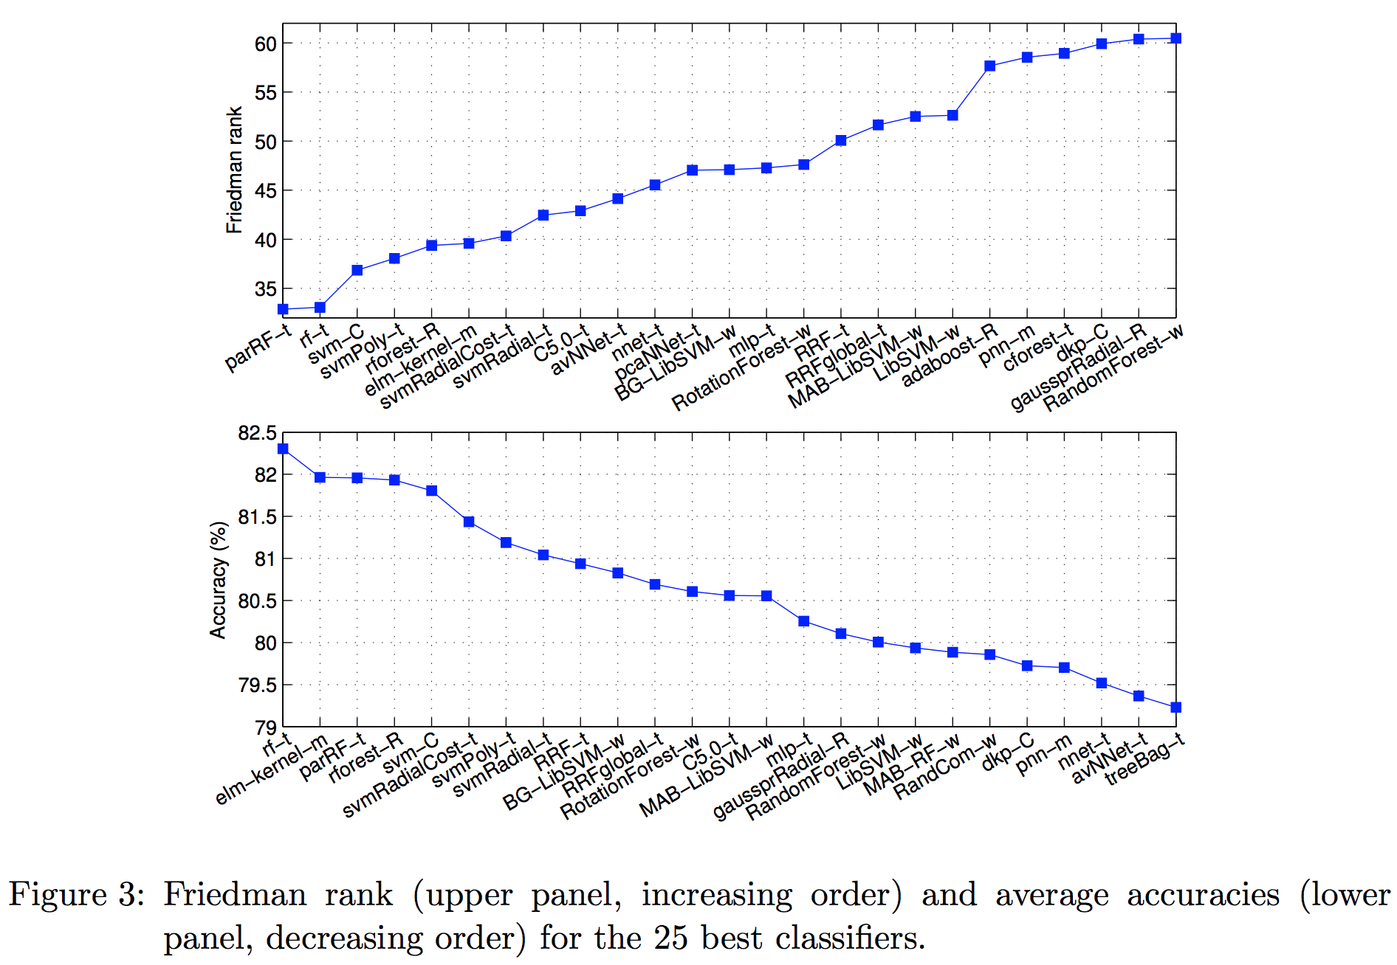
Random Forests Are Amongst the Best
People have done meta-analysis of ML algorithms, and random forests often come out at or tied for the top.
The results from a study * that put 179 different ML techniques against 121 different datasets is on the right.
Note: If random forests are not on top, our topic for lecture 5 is.
* M. Fernandez-Delgado, E. Cernadas, S. Barro, and D. Amorim. Do we Need Hundredsof Classifiers to Solve Real World Classification Problems?The Journal of MachineLearning Research, 15(1), pp. 3133–3181, 2014

Slide 43
Agenda
Class review
Bootstrapping
Bagging
Random Forests
General Ensembling
Summary

Slide 44
Bagging/Ensembling many methods
So far, we’ve always bagged many instances of a single ML model, but nothing stops us from combining the results from many different models into one!
Different types of ML algorithms will make different kinds of errors, so averaging can mitigate the biases of each technique
Ensembling is the general term for combining many distinct models together (often trained on the full dataset).
There is no clear theory around it, but there is no doubt it works!

Slide 45
A famous example: The Netflix Prize
The famous Netflix Prize (the goal to reduce the RMSE in predicting star ratings by 10%) was rather infamously won by two teams merging together and ensembling their results
In the final ensemble, they used a combination of over 800 different predictors that the two teams had developed over three years of competition.
While great for competition, it is worth noting that the final solution was useless to Netflix as it contained fairly few new ideas, and was too slow to run in production: ensemble with caution!

Slide 46
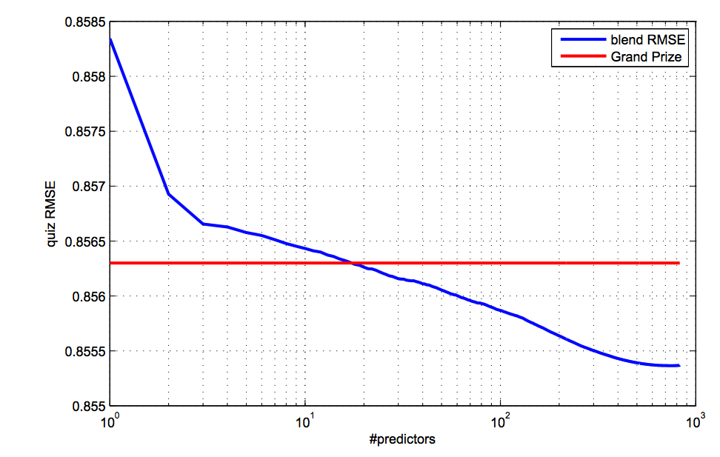
A famous example: The Netflix Prize
Figure on the right shows the way that their RMSE depended on the number of distinct predictors they ensembled (From their report ).
Note that the final number used is about 800 distinct predictors.
Although they note only 18 are needed to win if chose carefully.

Slide 47
Agenda
Class review
Bootstrapping
Bagging
Random Forests
General Ensembling
Summary

Slide 48
Summary
We saw the idea of bootstrapping and how you can synthetically pretend you have a much larger dataset by repeatedly sampling
We turned this into the method of bagging which allowed us to combine many models trained on the same dataset
Random Forests were an extension of this with extra randomization
We then turned to general ensembling, and saw how training many distinct techniques and letting them vote could lead to incredible increases in prediction

Slide 49
Summary
We will turn to various benefits you get by working with random forests, in particular:
Proximities: see how can we get an understanding of similarities of datapoints from bagged tree models, and use this as a method of supervised data visualization.
Feature Importances: See how we can use random forests to understand how important a feature is to the predictions of our models, and how this can inform feature selection.

Slide 50
Final Project – Predict Pet Adoption Time
You will working with pet adoption data from Austin Animal Center.
We joined two datasets that cover intake and outcome of animals. Intake data is available from here and outcome is from here.
We want you to predict whether a pet is adopted within the 30 days stay time in the animal center.
We give you a starter notebook: DTE-FINAL-PROJECT.ipynb
Dataset schema:
Pet ID - Unique ID of pet
Outcome Type - State of pet at the time of recording the outcome
Sex upon Outcome - Sex of pet at outcome
Name - Name of pet
Found Location - Found location of pet before entered the center
Intake Type - Circumstances bringing the pet to the center
Intake Condition - Health condition of pet when entered the center
Pet Type - Type of pet
Sex upon Intake - Sex of pet when entered the center
Breed - Breed of pet
Color - Color of pet
Age upon Intake Days - Age of pet when entered the center (days)
Time at Center - Time at center (0 = less than 30 days; 1 = more than 30 days). This is the value to predict.

Slide 51
Libraries-tools and licenses
Numpy: BSD
Pandas: BSD
Sagemaker: Apache license 2.0
Seaborn: BSD
Sklearn: BSD
Matplotlib: BSD
CatBoost: Apache license 2.0
LightGBM: MIT
XGBoost: Apache license 2.0
MXNet: Apache license 2.0

